Slide 1

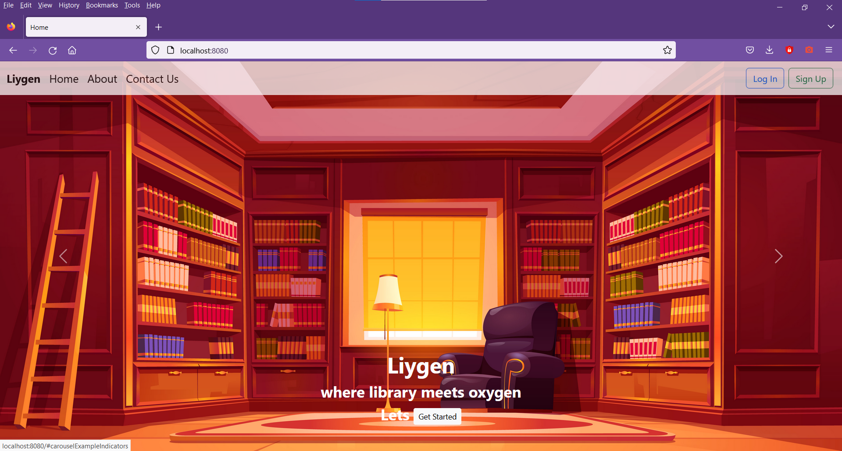

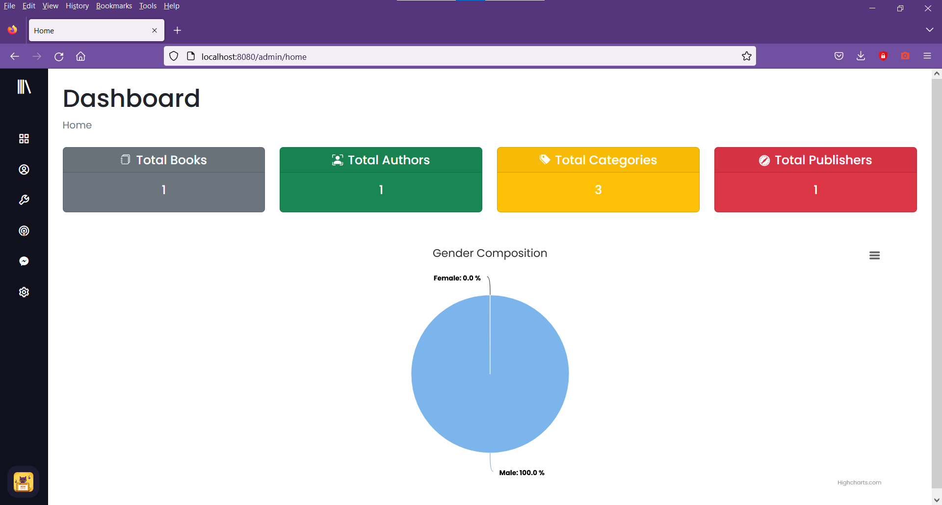





LIBRARY MANAGEMENT SYSTEM
2000031360, 2000031735, 2000031450
Department of CSE(Honors), KLEF
Introduction
Modules
Output Screenshots
Problem Statement
Admin:
Admin Module is prepared for managing the all users data, and can update and monitor the necessary information associated with library like books, authors, etc.
User:
User Module makes use of all the generated data. Users can download and view required data.
Design a Web Application using Java Full Stack for Library Management System (LMS)
Proposed Solution
Usually, the manual library management method run with pen and paper and lot of records. This approach consume more time and lacks a proper data organization structure. This library Management System is a more efficient and improved approach to manage library. It is more secure and reliable than the traditional ways. It is very easy to use the Library Management System. The user credentials makes the details of the library secure from others.
Block Diagram
Users
Admin
User
Project Advantages
Library Management System
It is more secure and reliable than the traditional method
The user credentials makes the details of the library secure from others.
Enhances productivity in Operations.
No more manual work.
Reduce inaccuracies
Server
Database
Download Data
Analyse
Notes:
Problem Statement, Proposed Solution then Advantages of Proposed Solution [First Column]
Modules – Mention modules with their operations [Second Column] Block Diagram – System Architecture / Project Flow [Second Column] Output Screenshots – Use this space to include your project screenshots in such a way that all images must be of same size and properly aligned (You can include images side by side also). You can add one more slide of same size to include more screenshots.

Slide 2

